Slide 1










MACHINE LEARNGING ANALYSIS OF PLAYER STASTICS
Presented by Mohamed Amr

Slide 2


OVERVIEW
01
02
Our Team
Our Mision
03
04
05
Data preprocessing
Data visualization
Ml Models

Slide 3






OUR TEAM
Mohamed Amr
Artificial intelligence
Abdallah saad
Communication engineering
Abdulrahman Taha
Computer engineer
Khaled Zakria
Mohamed Hamed
Artificial intelligence
Computer and communication engineering

Slide 4


MISION
My mission in this project is to leverage the power of machine learning and data visualization to assist football scouts in efficiently identifying top-performing players across the top 5 leagues. By providing a user-friendly interface and insightful visualizations through Power BI, this project aims to simplify the scouting process, enabling clubs to make data-driven decisions when selecting players based on their unique requirements and performance metrics

Slide 5




DATA PREPROCESSING
Data Cleaning
Data Exploration
is the process of correcting or removing inaccuracies, inconsistencies, and missing values in a dataset to ensure data quality and reliability for analysis
is the initial process of analyzing and visualizing a dataset to discover patterns, trends, and insights, as well as to understand its structure and relationships between variables

Slide 6

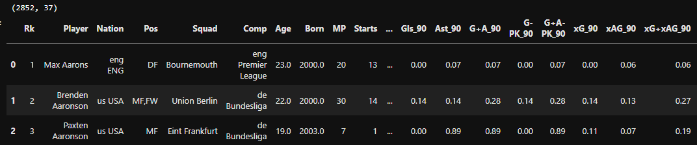
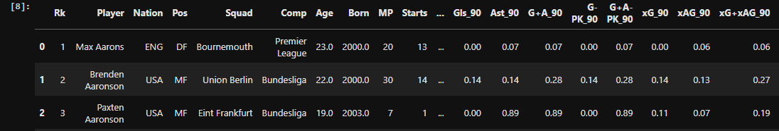
DATA CLEANING
The first chart represents the data before cleaning, showing key metrics for players, including goals, assists, and expected goals per 90 minutes.
The second chart displays the data after cleaning, with the same set of players and metrics. The refined data offers clearer insights into their performances, such as goals, assists, and expected assists per 90 minutes

Slide 7
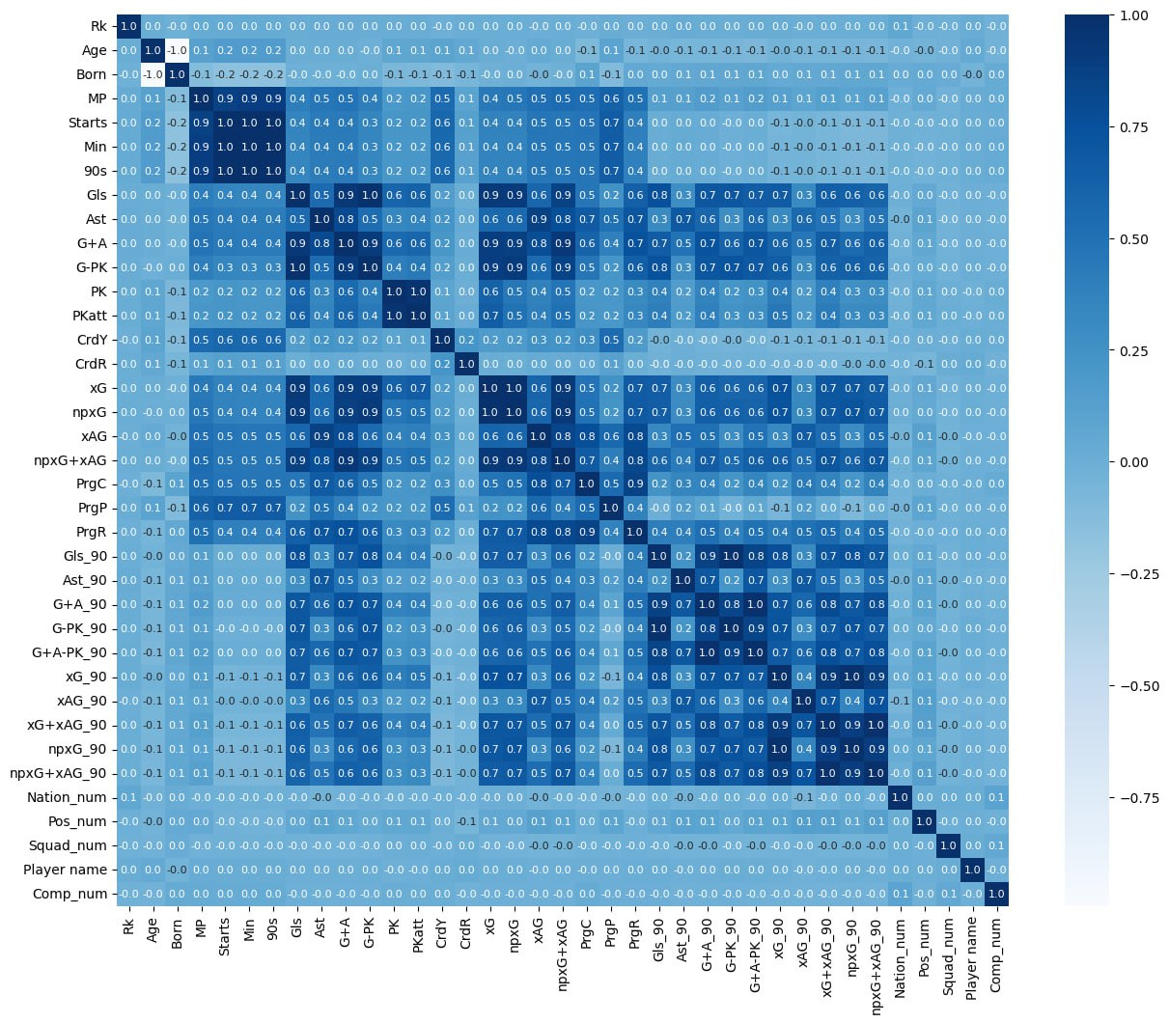
DATA EXPLORATION
THIS IMAGE APPEARS TO BE A HEATMAP OR VISUALIZATION OF PLAYER STATISTICS FOR VARIOUS METRICS IN A SPORTING CONTEXT. SOME KEY OBSERVATIONS:
The image is divided into rows representing different player metrics, such as Rk (Rank), Age, Born, MP (Minutes Played), Starts, Min (Minutes), 90s, Gls (Goals), Ast (Assists), G+A (Goals + Assists), G-PK (Goals excluding Penalty Kicks), PK (Penalty Kicks), PKatt (Penalty Kick Attempts), CrdY (YELLOW CARDS), CRDR (RED CARDS), AND SEVERAL ADVANCED STATS LIKE XG, XAG, NPXG, ETC.
THE COLUMNS SEEM TO REPRESENT INDIVIDUAL PLAYERS, WITH THEIR NAMES SHOWN AT THE BOTTOM OF THE IMAGE.
THE COLOR CODING RANGES FROM DARK BLUE (LOW VALUES) TO BRIGHT YELLOW (HIGH VALUES), ALLOWING FOR EASY VISUALIZATION OF THE PLAYER'S PERFORMANCE ACROSS DIFFERENT METRICS.
THE DATA APPEARS TO BE COMPREHENSIVE, COVERING VARIOUS ASPECTS OF PLAYER PERFORMANCE, INCLUDING GOALS, ASSISTS, CARDS, AND ADVANCED ANALYTICS LIKE EXPECTED GOALS AND EXPECTED ASSISTS.
THIS TYPE OF VISUALIZATION COULD BE USEFUL FOR ANALYZING AND COMPARING THE PERFORMANCE OF PLAYERS ACROSS DIFFERENT LEAGUES OR TEAMS, AS WELL AS IDENTIFYING THEIR STRENGTHS AND WEAKNESSES BASED ON THE VARIOUS METRICS DISPLAYED.

Slide 8

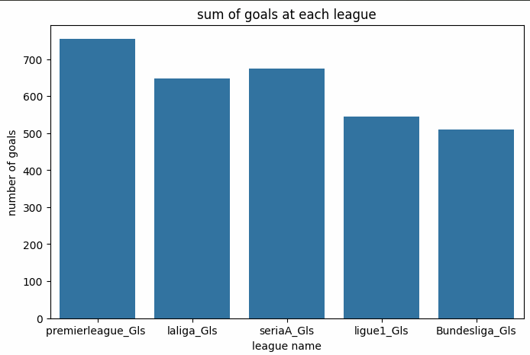
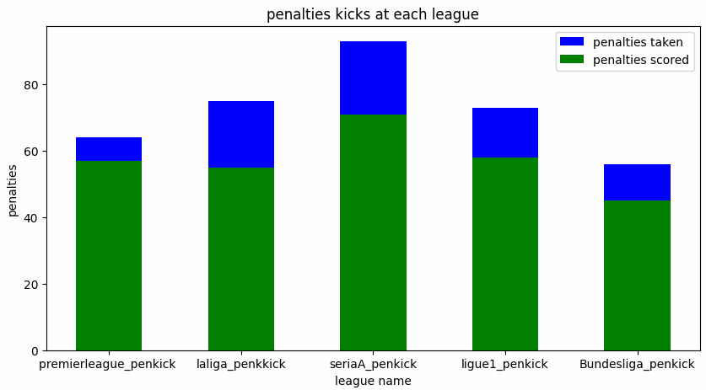
DATA EXPLORATION
The first chart shows the total number of goals scored in each league, with the Premier League having the highest total goals and Bundesliga the lowest.
The second chart displays penalty kicks at each league, comparing the number of penalties taken and penalties scored, with Serie A leading in both metrics.

Slide 9
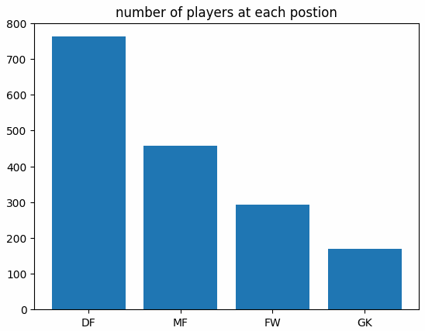
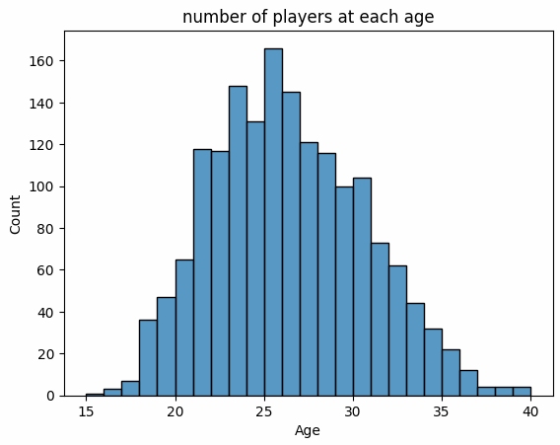
DATA EXPLORATION
The first image shows a graph of the number of players at each age, with the highest concentration between the ages of 25 and 30. 2. The second image shows a bar graph of the number of players at each position, with the highest number of players being at the DF (Defender) position.

Slide 10
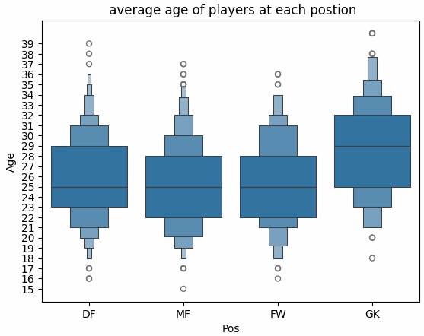
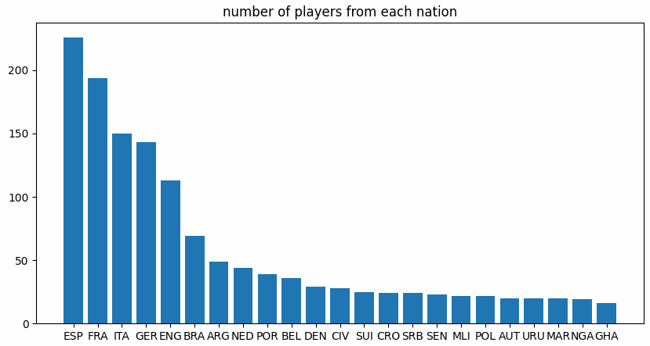
DATA EXPLORATION
The first image shows a box plot of the average age of players at each position, with GK (Goalkeeper) having the highest average age and DF (Defender) having the lowest
. The second image shows a bar graph of the number of players from each nation, with ESP (Spain) having the highest number of players.

Slide 11
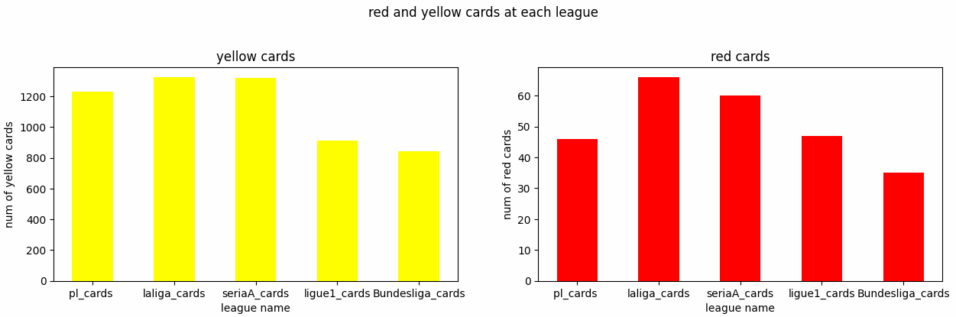
DATA EXPLORATION
The first image shows a bar graph of the number of yellow cards awarded in different leagues, with pl_cards having the highest number. The second image shows a bar graph of the number of red cards awarded in different leagues, with pl_cards having the highest number.

Slide 12

DATA VISUALIZATION
Power Bi
Power BI is a comprehensive business analytics service by Microsoft that enables users to connect, transform, visualize, and share data-driven insights and interactive reports.

Slide 13
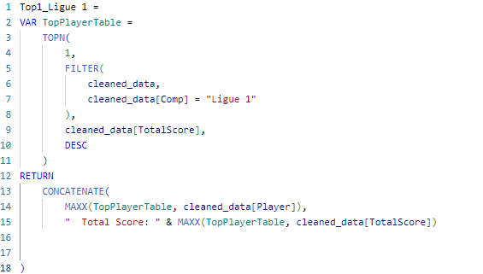

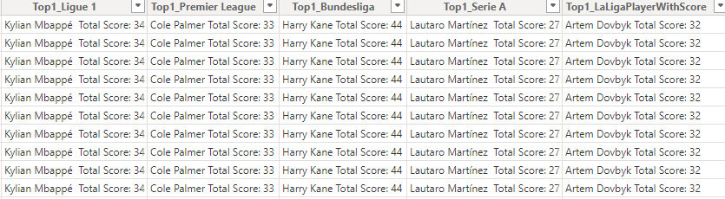
Data visualization
calculate column
The code creates a new table called "Top1_Ligue1" with a single column.
Inside the "TOP" function, it filters the data to only include rows where the "cleaned_data[Comp]" column is equal to "Ligue 1".
It then selects the "cleaned_data[TotalScore]" column and sorts the results in descending order using the "DESC" function.
Finally, the code uses the "CONCATENATE" function to create a new column that combines the text "Total Score: " with the maximum value from the "cleaned_data[TotalScore]" column.
This code is designed to create a new table that shows the top player in the Ligue 1 league based on their total score. The same process is then repeated for the other four top leagues (Premier League, Bundesliga, Serie A, and LaLiga) to create similar tables for those leagues.
The goal of this code is to provide a way to quickly identify the top-scoring player in each of the major European football leagues, which can be useful for analysis and comparison purposes.

Slide 14
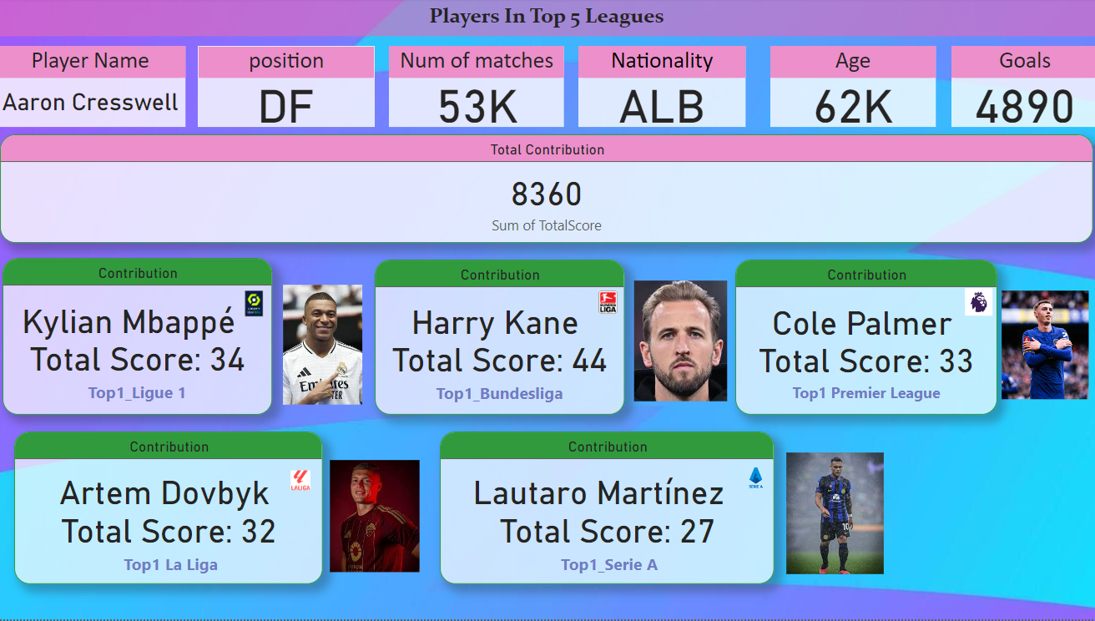

Data visualization
visualization
This image provides information about the top players in the top 5 leagues. It displays details about 5 different players:
Kylian Mbappe - A player in France's Ligue 1 league with a total score of 34.
Harry Kane - A player in Germany's Bundesliga league with a total score of 44.
Cole Palmer - A player in England's Premier League with a total score of 33.
Artem Dovbyk - A player in Spain's La Liga with a total score of 32.
Lautaro Martínez - A player in Italy's Serie A with a total score of 27.
The image also shows the total contribution score of 8,360 for all the players combined.

Slide 15
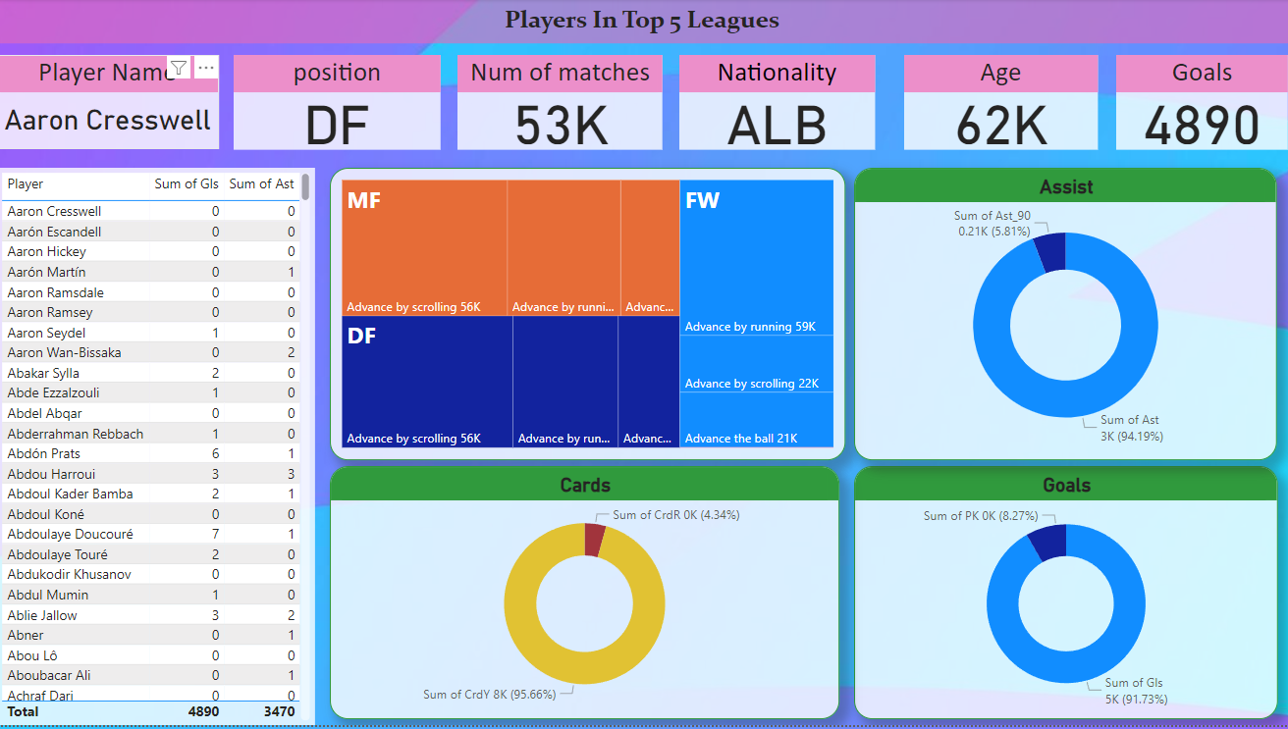
Data visualization
visualization
1- Assist Breakdown:
Sum of Assists: 3470 (94.19%)
Sum of Ast 90: 0.21 (5.81%)
2- Goals Breakdown:
Sum of PK : 0K (8.27%)
Sum of Gls: 5K (91.73%)
3- Cards Breakdown:
Sum of CrdY: 8K (95.66%)
Sum of CrdR: 0K (4.34%)

Slide 16
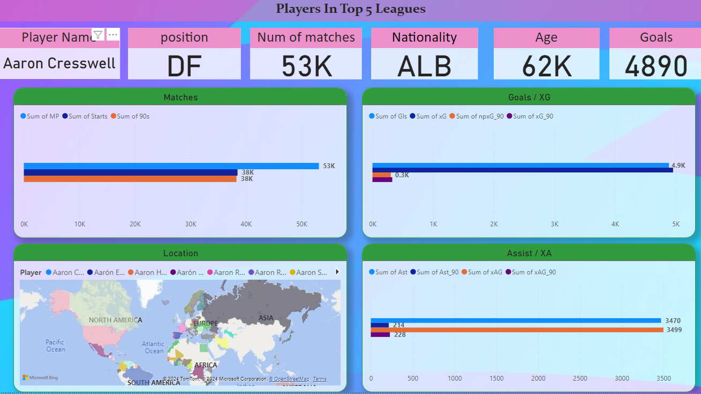
Data visualization
visualization
Matches:
- The chart shows the number of matches played (MP), starts, and 90s minutes played over the course of his career.
Goals/xG:
- This chart displays Cresswell's goal-scoring stats, including total goals scored, expected goals (xG), non-penalty expected goals (npxG), and expected goals per 90 minutes (xG/90).
Assist/xA:
- The chart shows Cresswell's assist stats, including total assists, expected assists (xA), and the sum of his assist-related metrics.
Location:
- A world map shows the geographic distribution of the various "Aaron" players, highlighting Cresswell's position in Europe.

Slide 17

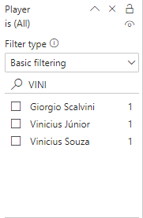




Data visualization
Choose any player from the list
2. It will show all the statistics of the selected player

Slide 18

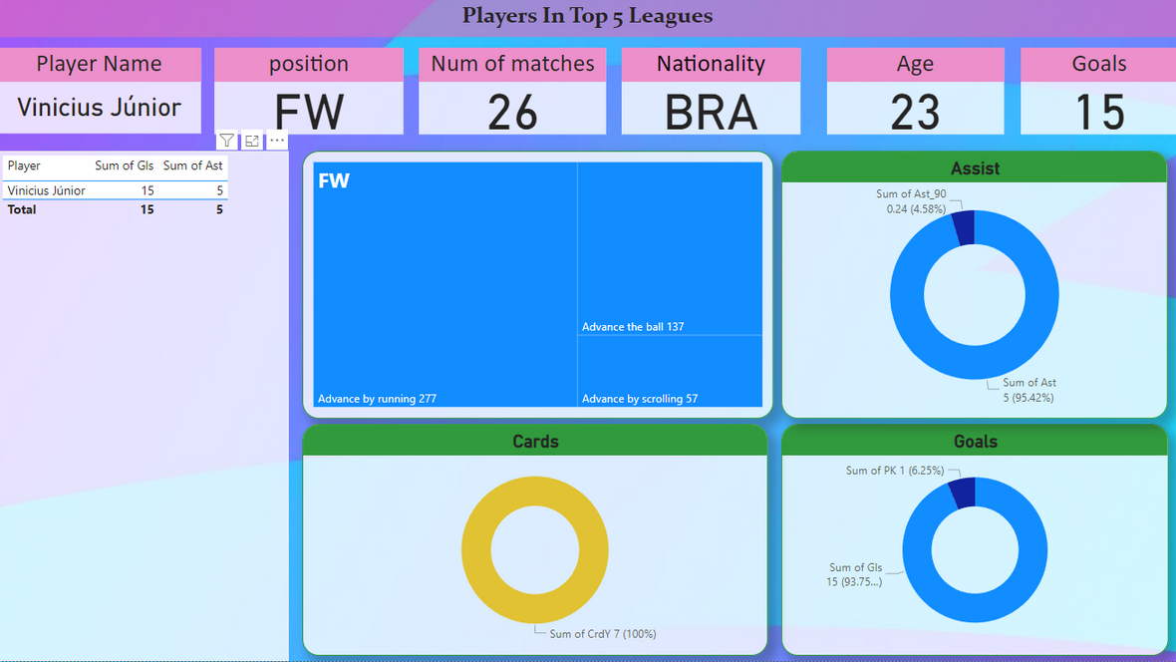
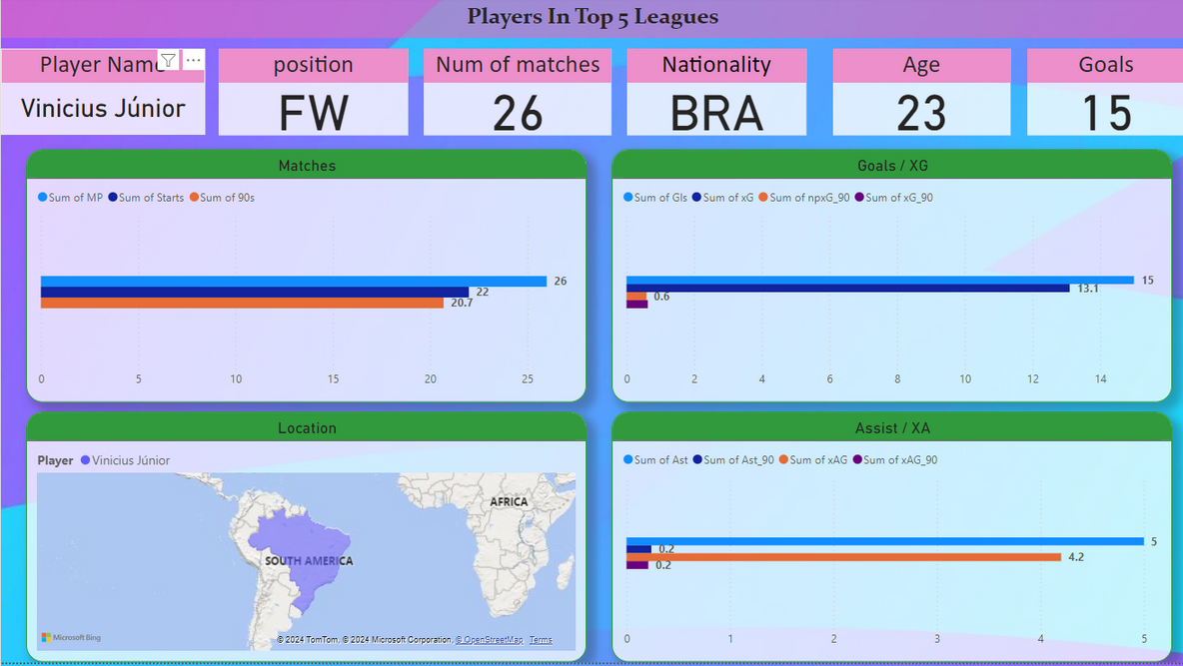
Data visualization
It will show all the statistics of the selected player

Slide 19
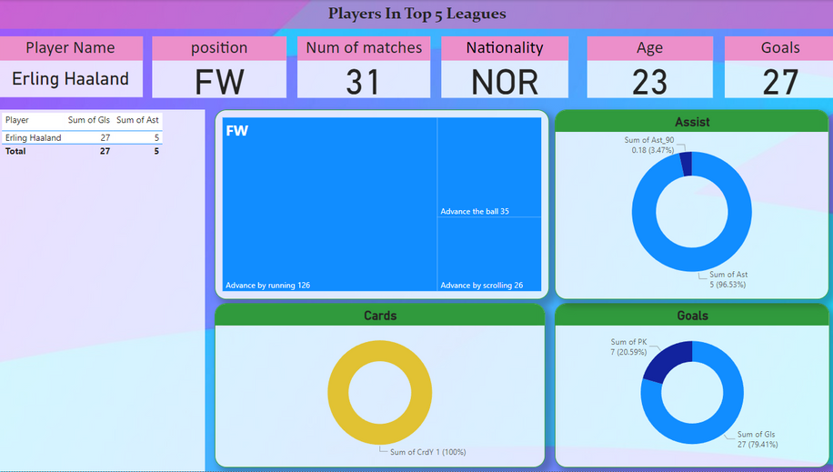

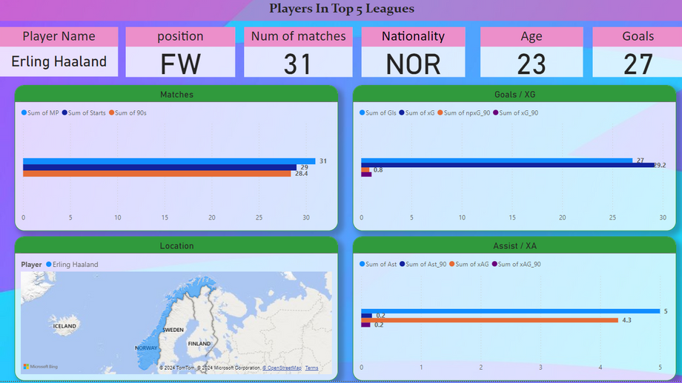
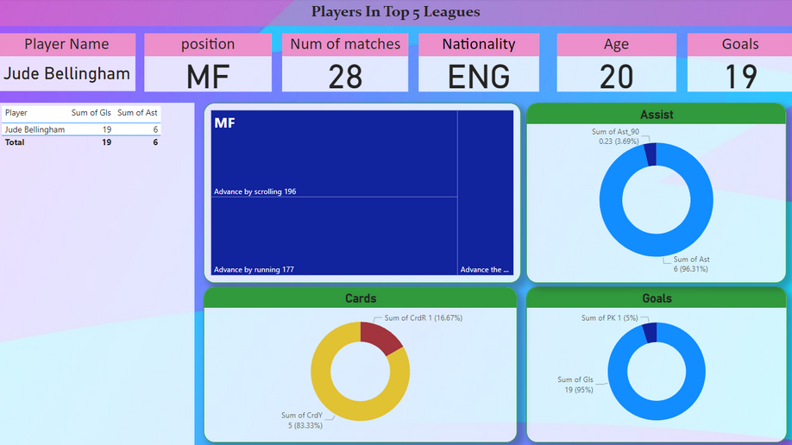

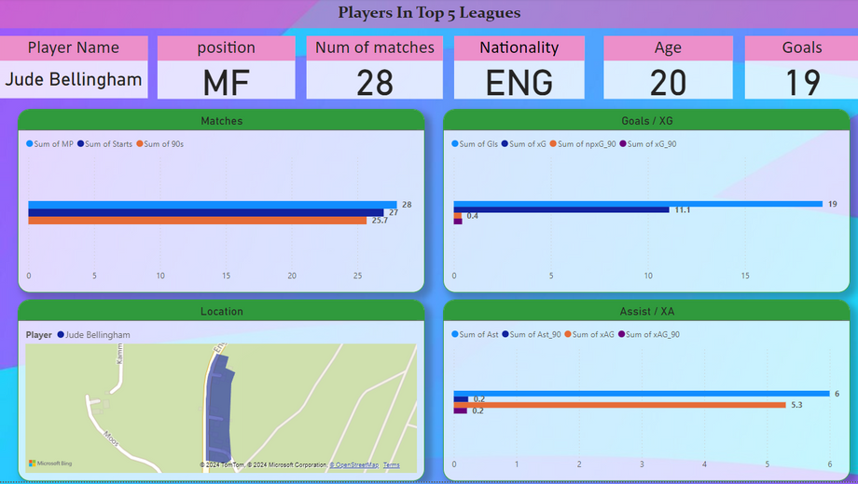
Data visualization
We will choose a player from each position to compare statistics

Slide 20
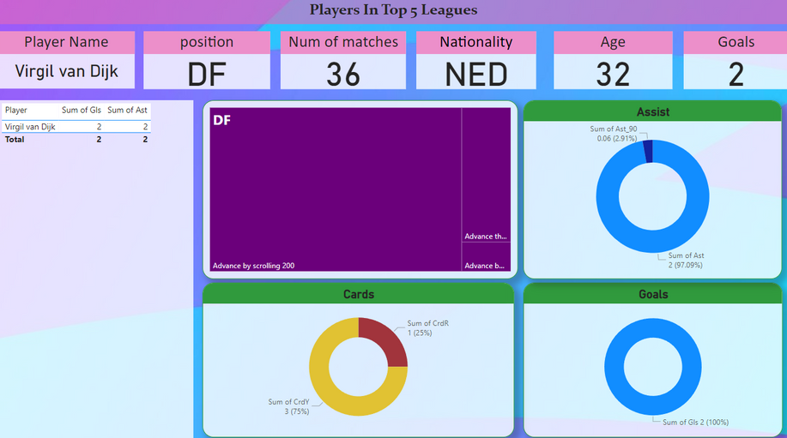
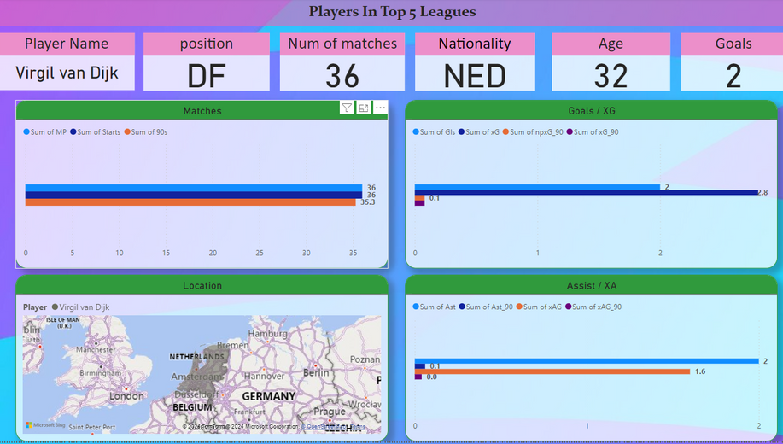

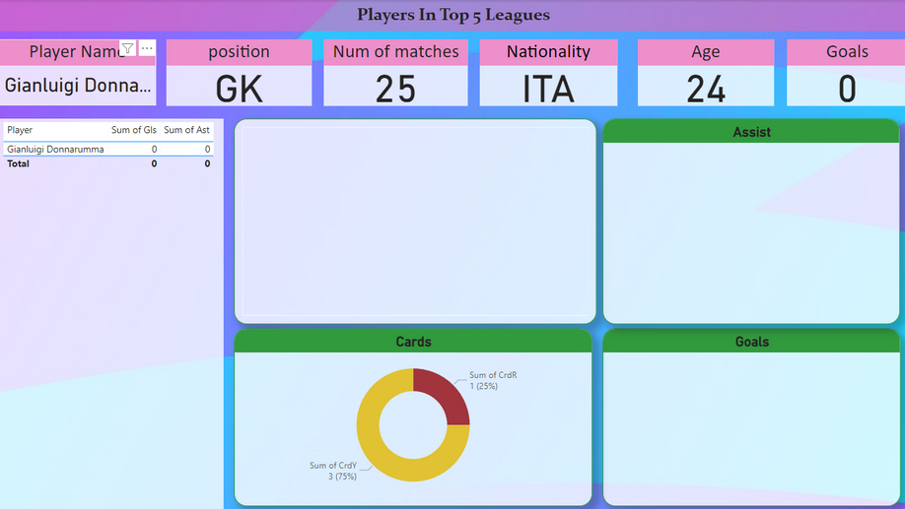
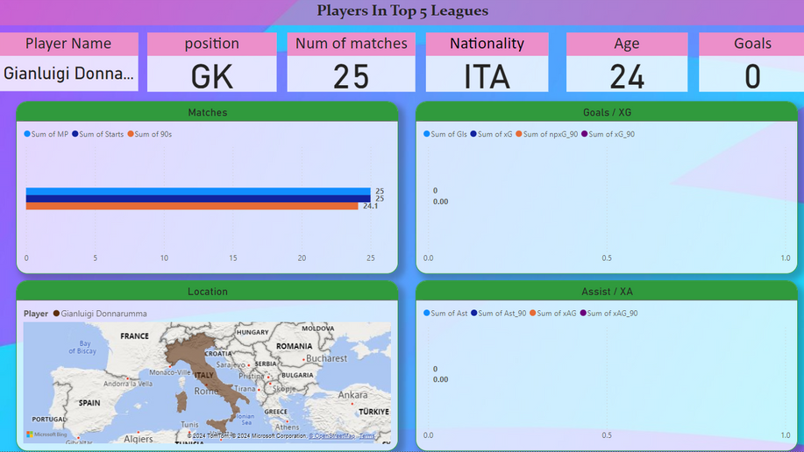

Data visualization
We will choose a player from each position to compare statistics

Slide 21

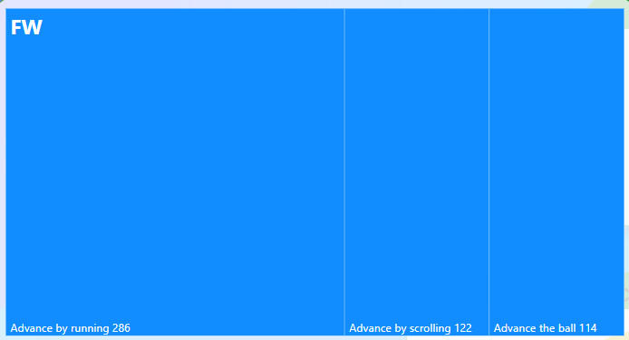
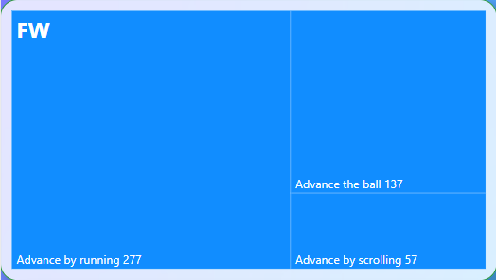

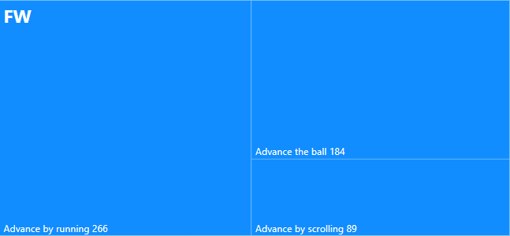
Data visualization
We will choose more than one player in the same position

Slide 22

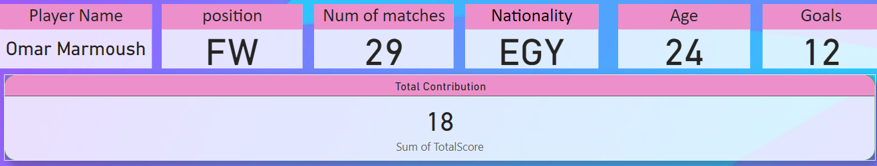
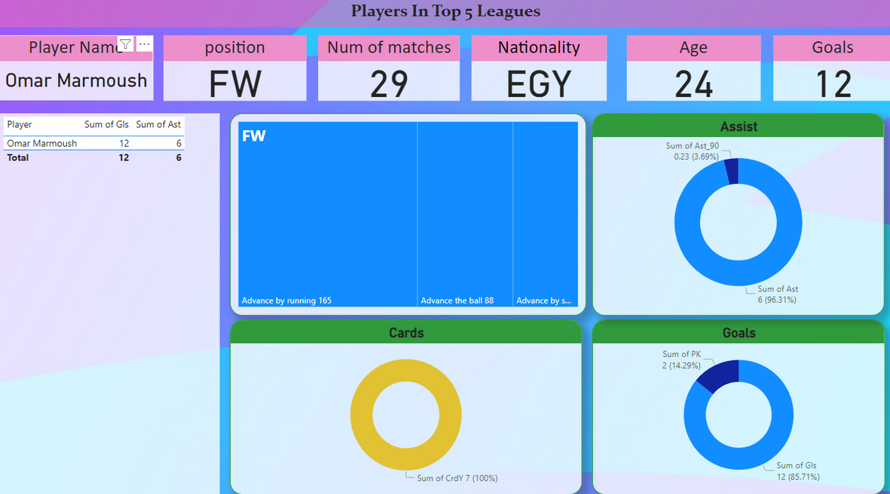
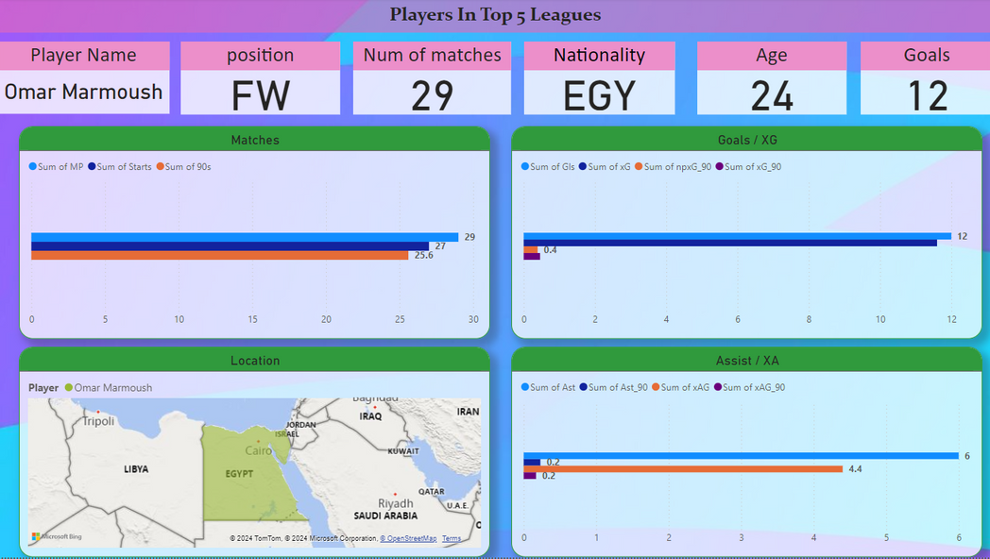
Data visualization
Predict an explosive season for any player based on his statistics

Slide 23

ML MODELS
Random forest
Decision tree
Linear regression
Svm
neural network
You are sending and receiving too many words in a short period of time.
The decision tree model recursively partitions the feature space into regions and predicts the target variable based on the most informative features.
Linear regression is a statistical model that estimates the linear relationship between a dependent variable and one or more independent variables.
Support Vector Machine (SVM) is a supervised learning algorithm that finds the optimal hyperplane to separate data points of different classes in a high-dimensional space
computational model inspired by the human brain, consisting of interconnected layers of nodes (neurons) that process and learn from data to perform tasks such as classification, regression, and pattern recognition

Slide 24
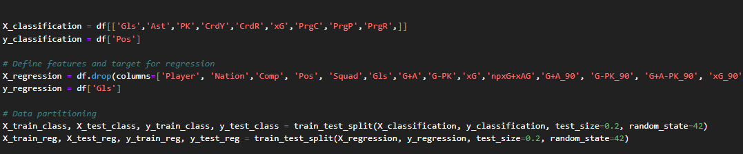
DATA PREPATION

Slide 25
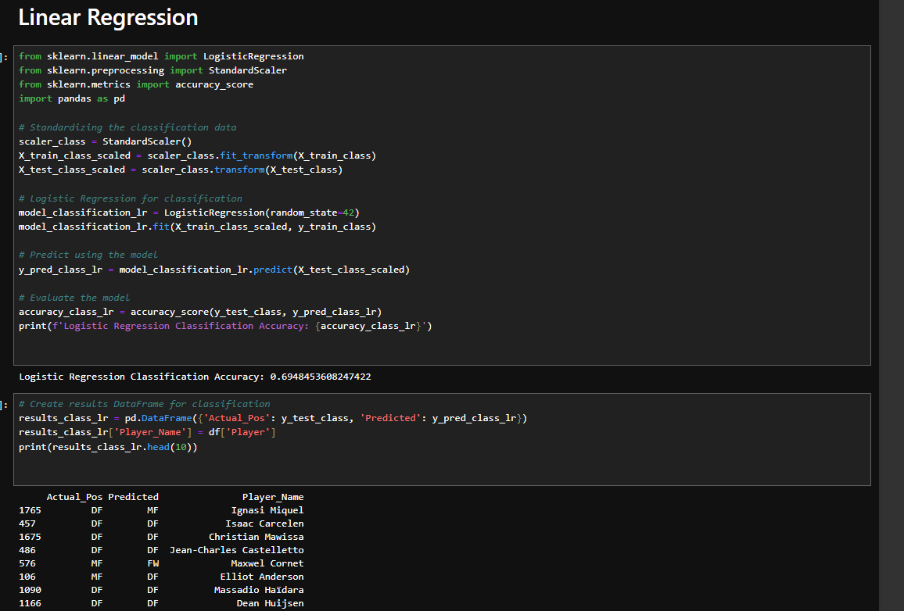
LINEAR REGRESSION
CLASSIFICATION

Slide 26
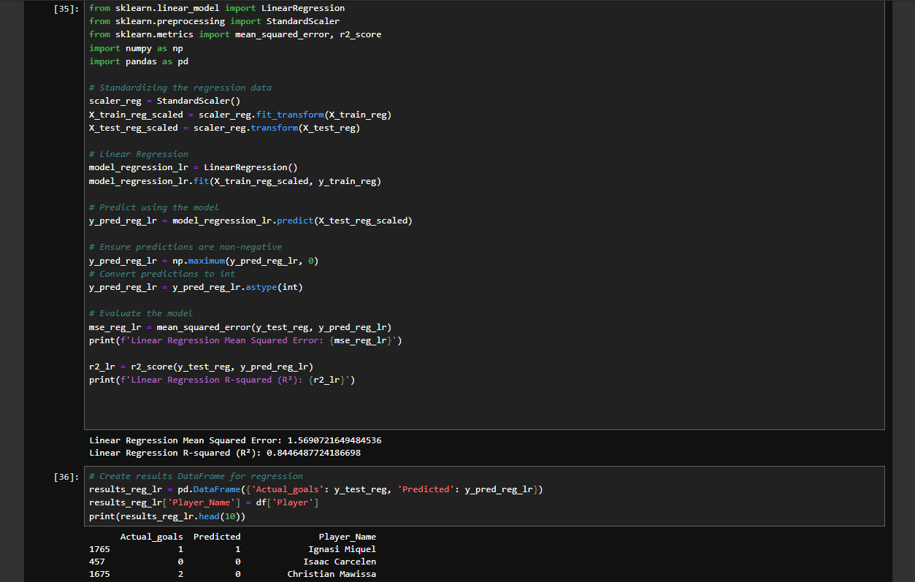
LINEAR REGRESSION
REGRESSION

Slide 27
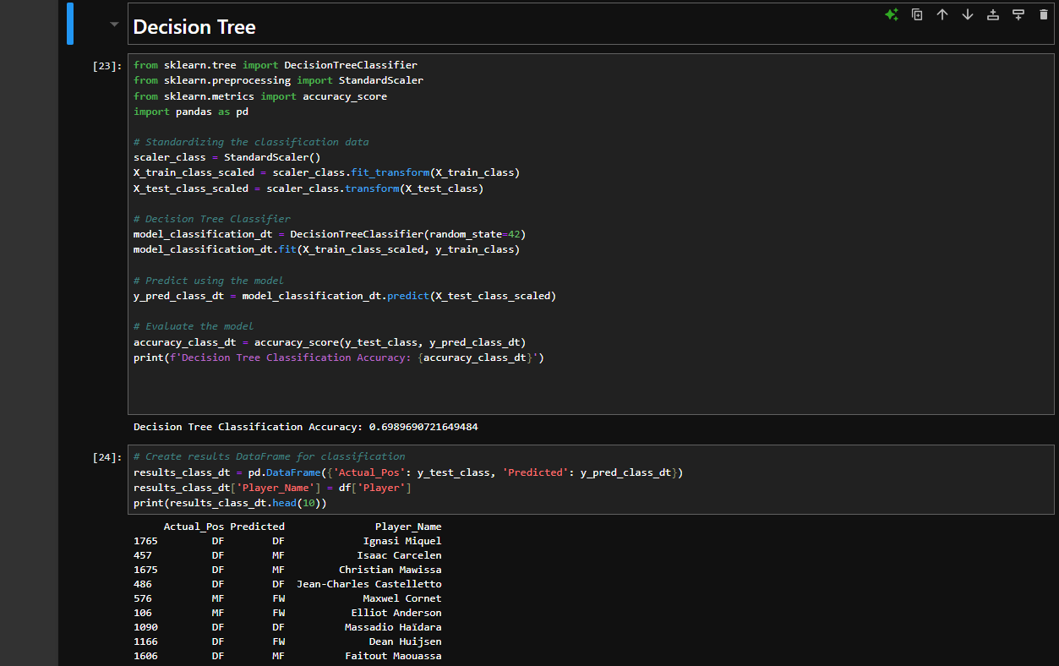
DECISION TREE
CLASSIFACATION

Slide 28
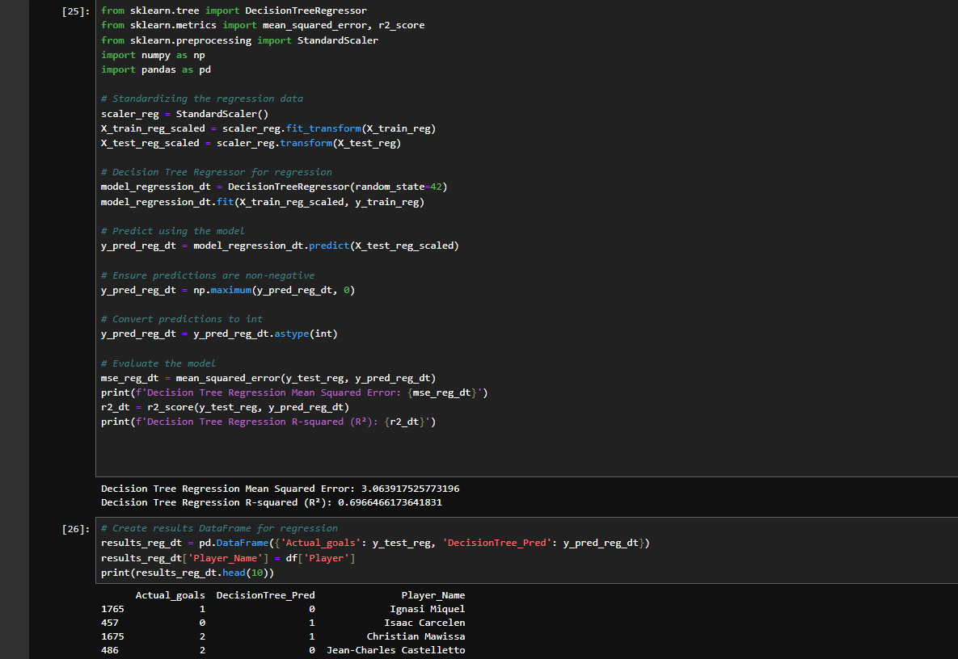
DECISION TREE
REGRESSION

Slide 29
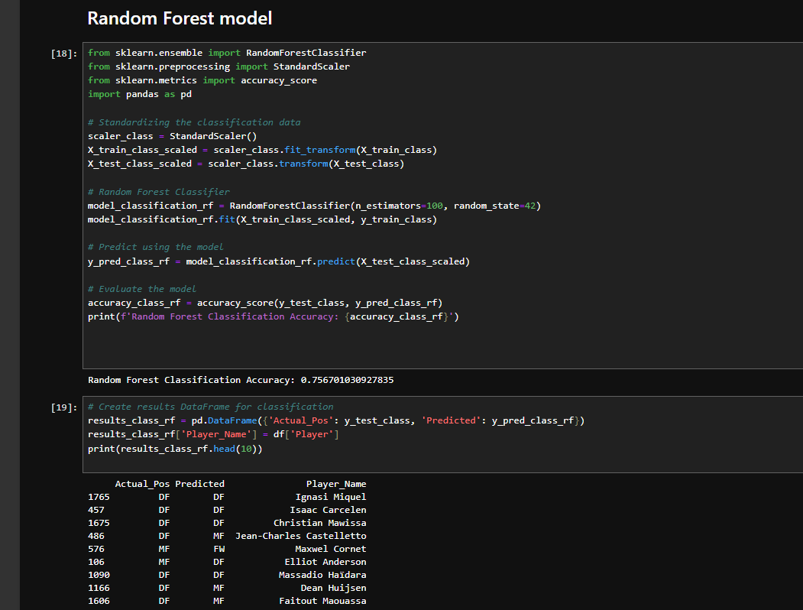
RANDOM FOREST
CLASSIFICATION

Slide 30
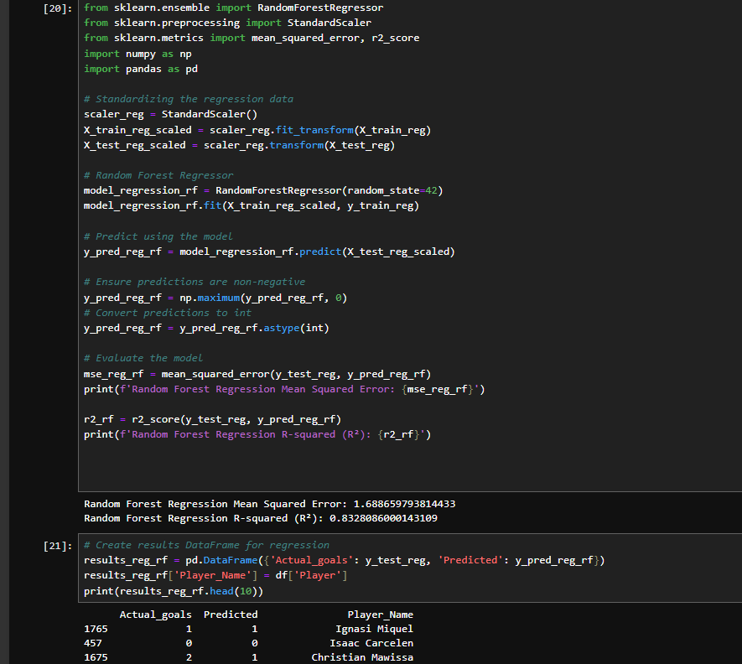
RANDOM FOREST
REGRESSION

Slide 31
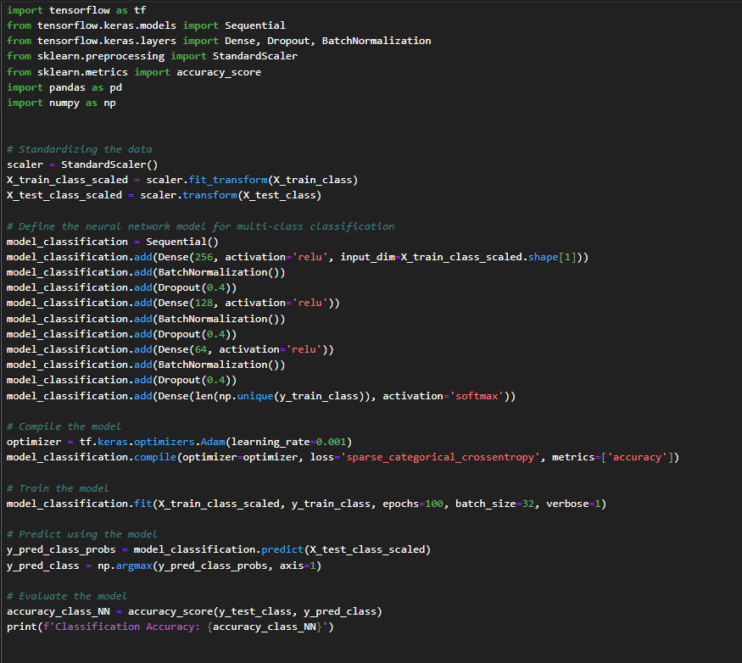
NEURAL NETWORK
CLASSIFICATION

Slide 32
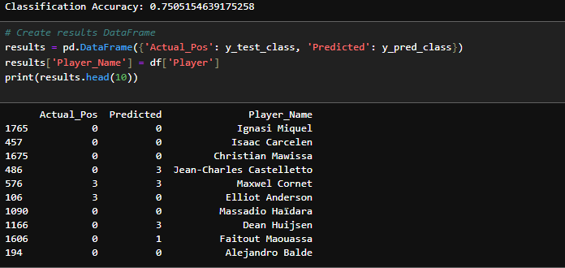
NEURAL NETWORK
CLASSIFICATION

Slide 33
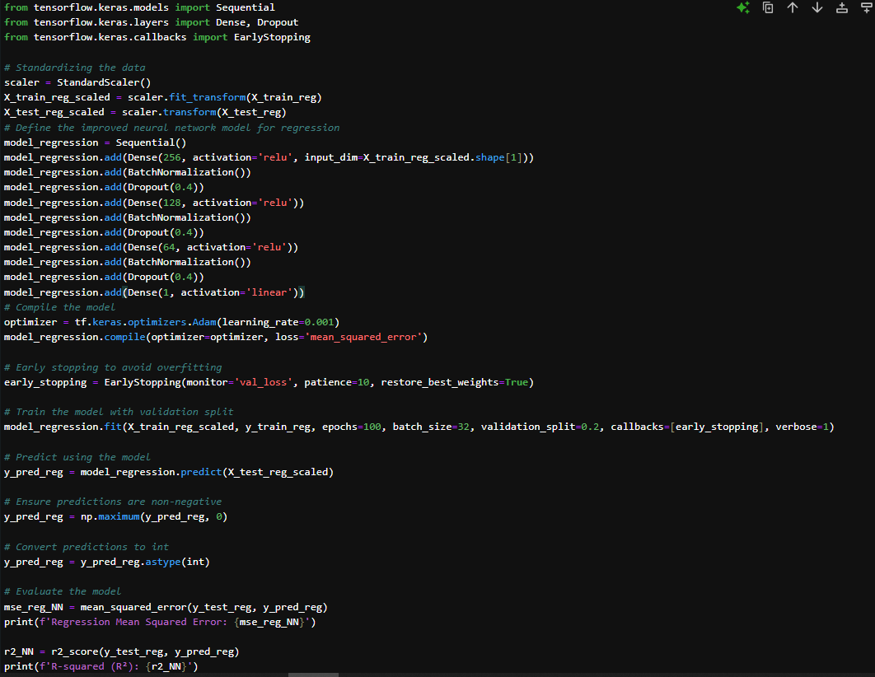
NEURAL NETWORK
REGRESSION

Slide 34
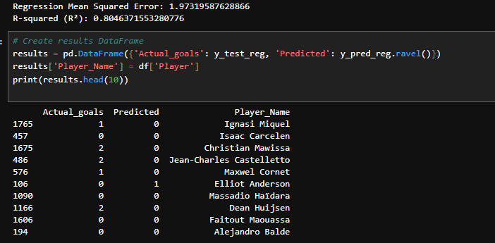
NEURAL NETWORK
REGRESSION

Slide 35
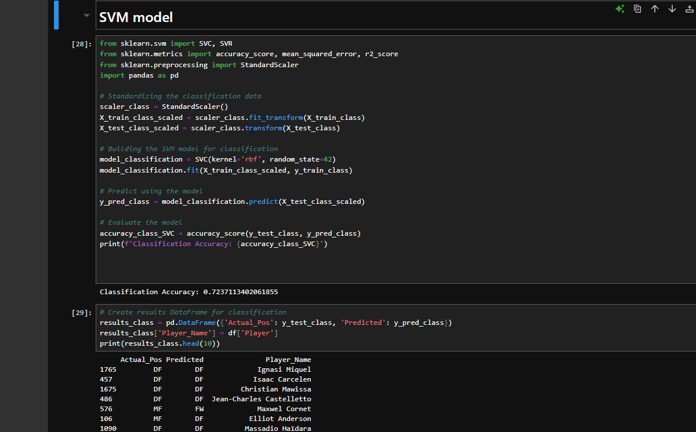
SVM
CLASSIFICATION

Slide 36
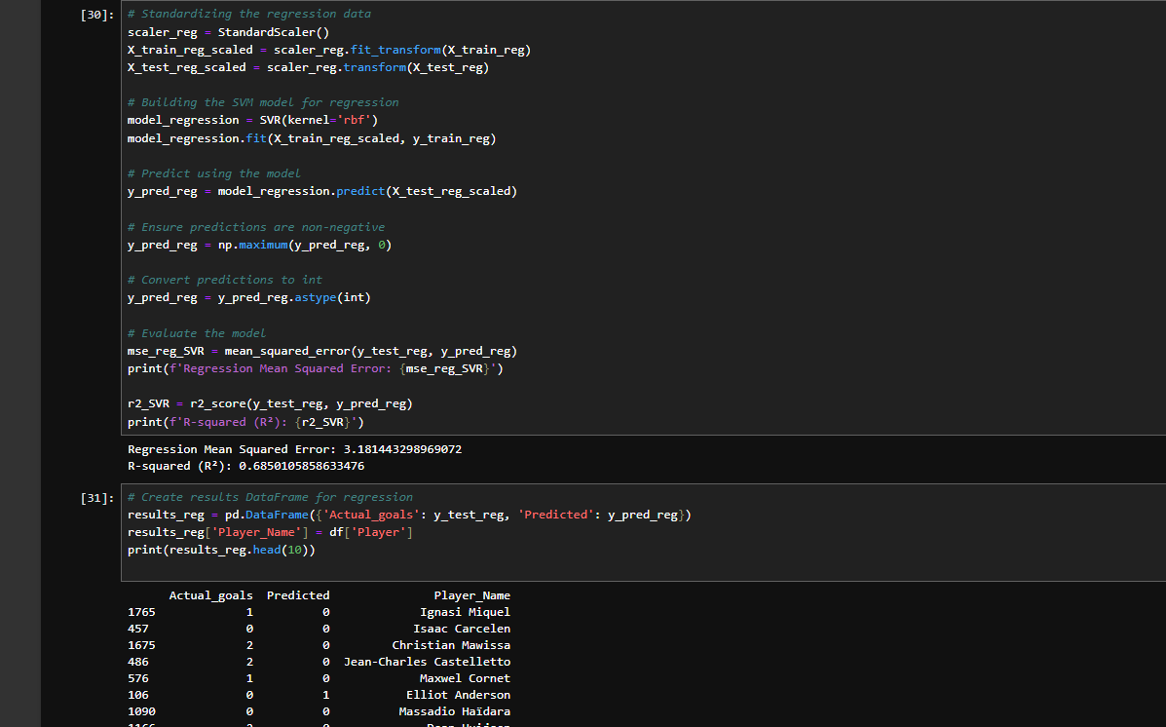
SVM
REGRESSION

Slide 37
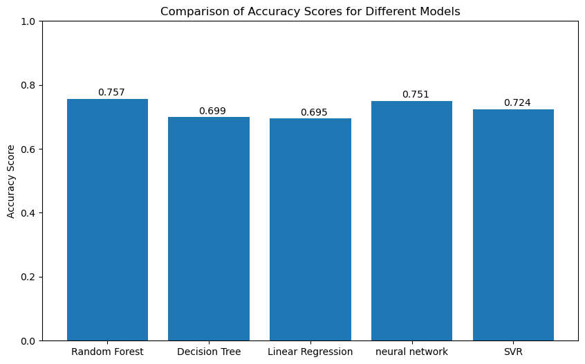
COMPARISON BETWEEN MODELS
ACCURACY

Slide 38
RANDOM FOREST IS THE BEST ONE FOR CLASSIFACATION

Slide 39
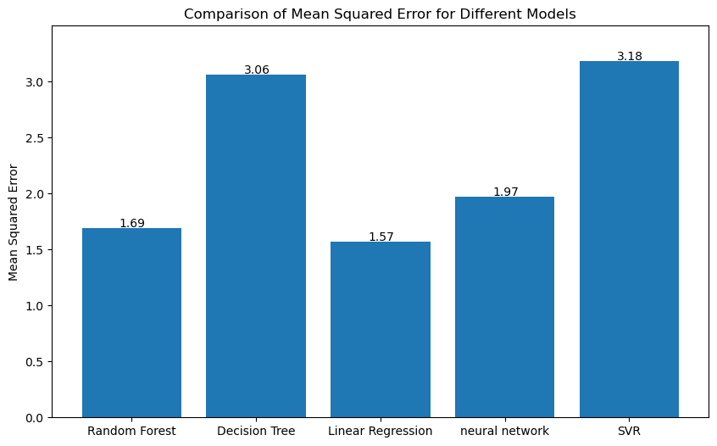
COMPARISON BETWEEN MODELS
MEAN SQUARED ERROR

Slide 40
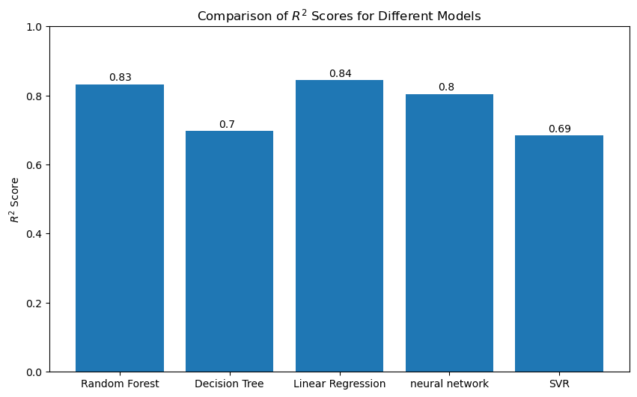
COMPARISON BETWEEN MODELS
R2 SCORES

Slide 41
LINEARREGRESSION IS THE BEST ONE FOR REGRESSION

Slide 42



Thank
You

